Slide 1
Predicting Precipitation with Machine Learning
Kaitlyn Lane, Patrick Ledoit, Jessica Ling, Conor Luppnow

Slide 2

Project Background
Why Rainfall Prediction?
Agricultural, economic impacts
Disaster mitigation: floods, landslides
Also:
Chaotic, not “easily” predictable
Breadth and type of meteorological data
Photo by Dibakar Roy from Pexels: https://www.pexels.com/photo/people-walking-in-the-rain-near-metropolitan-building-kolkata-india-18158842/
Notes:
We chose rainfall prediction as our project because it’s an interesting topic that impacts many people’s lives. Particularly in tropical areas, rainfall often has major agricultural and economic impacts from unpredictable rainfall. In India specifically, the population is 1.7 billion. There can also be catastrophic loss of human life from disasters like floods and landslides.
Rainfall prediction is also an interesting topic for ML application because it’s sufficiently chaotic to require complex modeling and hyperparameter tuning. Meteorological data often includes many features, such as humidity, dew point, and pressure, so with sufficient data complex relationships may be found between these attributes and rainfall.

Slide 3
Prior Work
Two open-source projects on the same Kaggle dataset
Gaurav, V. (2018):
Investigated 7 initial models without hyperparameter tuning and reported mean absolute error
Sudharsan, D. et al. (2021)
Random Forest, Lasso, Elastic Net models on 1 meteorological subdivision of India
Their Data: Monthly precipitation for 36 meteorological regions in India from 1901-2015
Notes:
We build from two open-source projects that worked on the same Kaggle dataset.
The first of these investigated 7 initial models without hyperparameter tuning and reported mean absolute error.
The second of these investigated 3 models, but only predicted on 1 meteorological subdivision out of 36.
These both used a Kaggle dataset which described monthly precipitation for all meteorological regions for the entire span of 1901 through 2015.

Slide 4
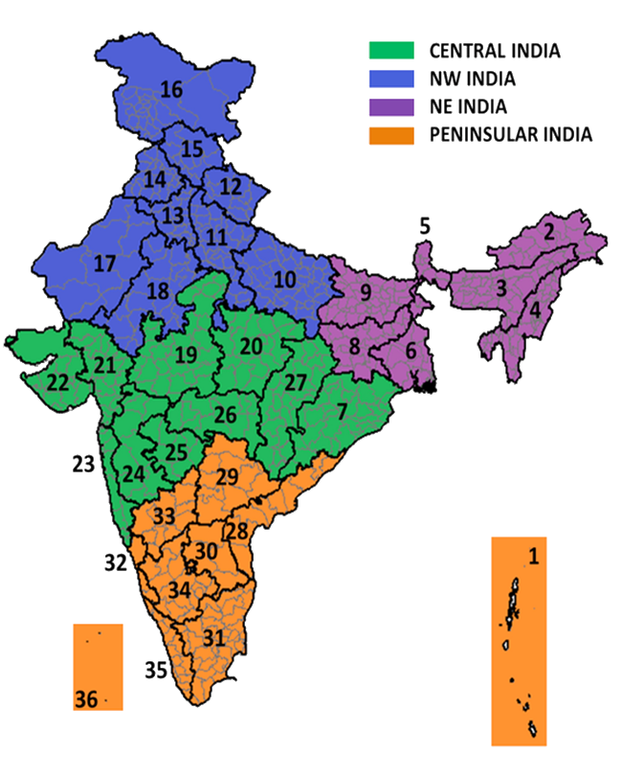
Prior Work - Major Failings
Their Data:
Extremely low dimensionality
Predict next month’s rainfall only on previous 3 months’
Their Models:
Little to no hyperparameter tuning
Limited Scope
Notes:
Neither of these works achieved very good results with respect to Mean Absolute Error, having a score of 85 at minimum. This is very significant considering the average monthly rainfall is 86 mm. This means that even for the best performing model, predictions for a given month were on average 85 millimeters off.
We analyzed that this was because of the low dimensionality of the dataset, which meant that next month’s rainfall would only be predicted based on the previous three months.
Furthermore, there was little to no hyperparameter tuning, and the scope was limited in that the model would only predict for a single subdivision.

Slide 5







Our Contribution Goals
Expand Data: acquire new, relevant features
Improve Models: test a wide range of models and tune hyperparameters
Notes:
Our contribution goals are twofold. First, expand the data. We can see from prior work that the results of predicting only on historical rainfall data are dismal, with Mean Absolute Error of at least 85 millimeters on rainfall. By acquiring new, relevant features that we know are linked to rainfall, we aim to improve predictive results. These include:Wind speed, Sea-level pressure, dew-point and Temperature.
Second, we can improve the performance of models by testing a wide range and tuning hyperparameters on each. We expanded on regression models used in prior work, which included ridge, elastic net, support vector, and random forest regression. In addition, we also added multilayer perceptrons and Linear Regression.

Slide 6
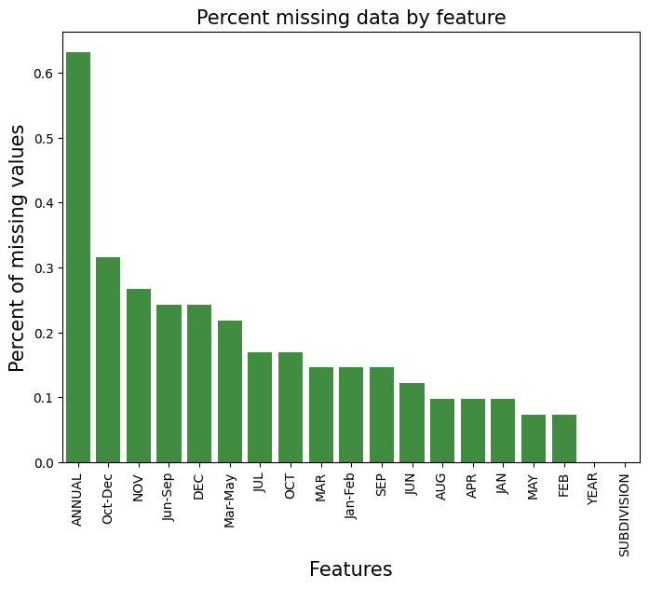

Contribution 1: Data
Initial Kaggle Dataset:
Data from 1901-2015
Monthly granularity
Rainfall Only
All 36 Meteorological Subdivisions
Missing data, primarily pre-1950
New Website:
Data from 2010-2020
Monthly granularity
Temperature, Dew Point, Precipitation, Wind, Sea Level Pressure
All 36 Meteorological Subdivisions + Delhi
No missing data
Notes:
Our first contribution involved

Slide 7
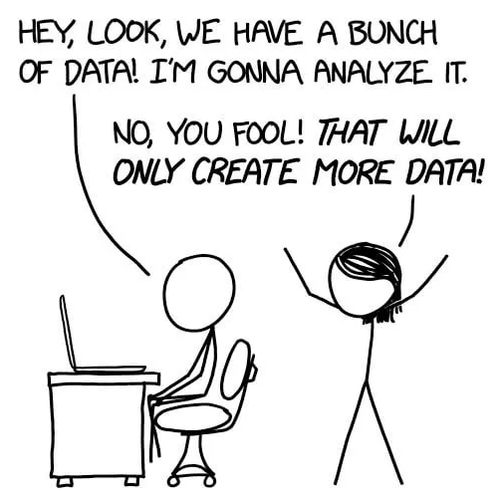
Data Collection Challenges
Weather data for the United States is readily available
For India the same is not true
Precipitation data readily available, not much else
Data was hidden behind paywalls or was only available in the form of graphs/charts
Sacrifice long time scale for detailed data over
Finally found detailed data from https://weatherandclimate.com/
Slightly obscure website that was difficult to find
Notes:
This gives us 10 year of complete monthly data
Caveat is that regions between datasets were slightly different

Slide 8
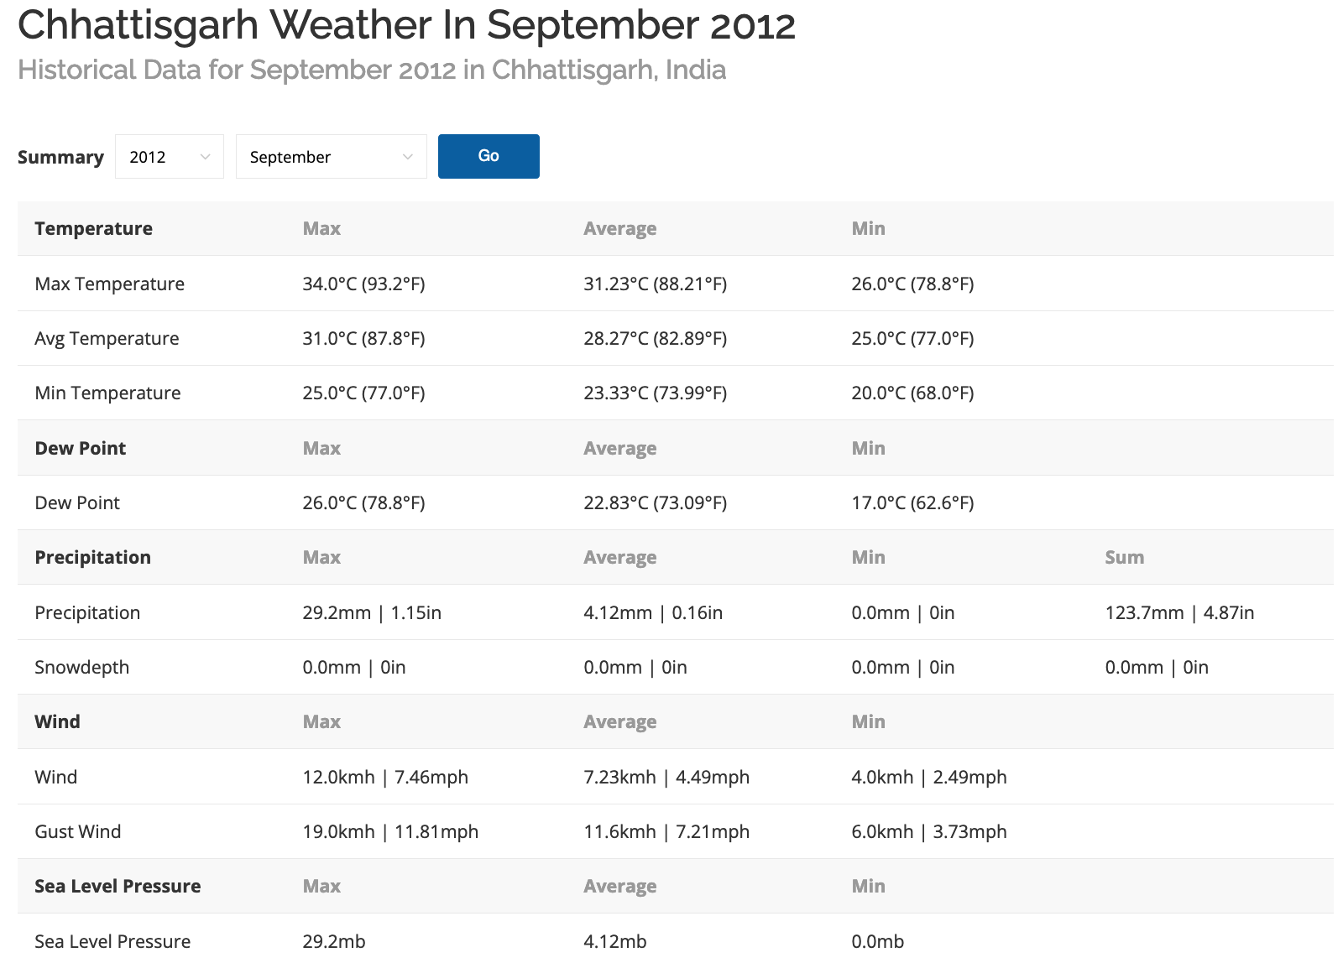
daily

Slide 9
Web Scraping
Month Year (2010-2020)
Meteorological Region:
Maharashtra
Manipur
Meghalaya
Mizoram
Nagaland
Odisha
Puducherry
Punjab
Rajasthan
Sikkim
Tamil Nadu
Andaman and Nicobar Islands
Andhra Pradesh
Arunachal Pradesh
Assam
Bihar
Chandigarh
Chhattisgarh
Dadra and Nagar Haveli
Daman and Diu
Delhi
Goa
Gujarat
Haryana
Himachal Pradesh
Jammu and Kashmir
Jharkhand
Karnataka
Kerala
Ladakh
Lakshadweep
Madhya Pradesh
Telangana
Tripura
Uttar Pradesh
Uttarakhand
West Bengal

Slide 10
Contribution 2: Improving Models
We used the following Models:
random forest regressor, support vector regression, elastic net, ridge, multilayer perceptron regressor, and linear regression.
Used sklearn’s gridsearchCV to obtain best hyperparameters, using three fold cross validation.
Comparing test results of the default and best parameters after hyperparameter tuning we saw very marginal improvements. (Outlier: SVR)
The issue with hyperparameter tuning is that the more parameters chosen to test, the longer the computation time.
Notes:
Contrib 2: improving models
After using data with more features the accuracy was much better, we want to squeeze out any performance by exper. With models and param tuning.
Used 4 of the same models as previous paper, added two new, MLP and linear regression models
Tuning slightly improved models for most cases, the outlier being the SVR which there is a large improvement.

Slide 11
Contribution 2: Optimal Hyperparameters
Out of the parameters sampled, listed below are the best sets obtained from gridsearchCV.
Random Forest Regressor | {'max_depth': None, 'min_samples_split': 2, 'n_estimators': 200}
SVR | {'C': 1, 'coef0': 0.01, 'degree': 3, 'kernel': 'linear'}
Elastic Net | {'alpha': 1, 'l1_ratio': 1, 'max_iter': 1000}
Ridge Regression | {'alpha': 3, 'max_iter': 200}
MLP | {'activation': 'relu', 'hidden_layer_sizes': (100,), 'learning_rate': 'constant', 'max_iter': 800}
Linear Regression | {'features': ‘sea_level_preassure_max_mb ’, ‘sea_level_preassure_avg_mb ’, ‘sea_level_preassure_min_mb ’, ‘wind_min_kmh’}
Notes:
Out of all params tested, this table shows the list of params that led to best results.
Issue with param tuning is that when you include num params, the compute time blows up.
Needed to balance good params and amount of time we have to wait for computation to run.

Slide 12
Overall Conclusions
Most of our performance improvements came from data collection
Feature selection was very important
Best-performance initially was Random Forest
Best-performing models after tuning: Linear Regression and Ridge Regression
Model | MAE (Original Dataset)[mm] | MAE (new dataset)[mm] | MAE (tuned params)[mm]
Random Forest Regressor | 85.69 | 2.252 | 2.091
SVR | 127.70 | 81.96 | 1.778
Elastic Net | 94.99 | 3.205 | 1.539
Ridge Regression | 94.90 | 1.55 | 1.50
MLP (New) | 87.19 | 4.322 | 3.211
Linear Regression (New) | 93.64 | 1.595 | 1.468 (1.7% error)

Slide 13
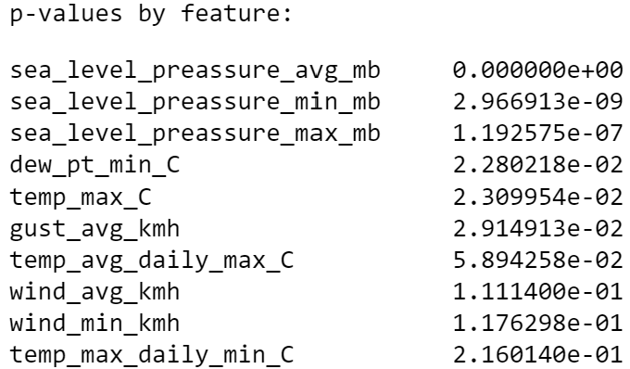
Future Works
Collect daily weather data across multiple years
Kaggle dataset maintained by Nidula Elgiryewithana started this by recording daily temperature beginning in August 2023 and stopped in April 2024
Create a dataset that contains daily weather predictors such as humidity, temperature, dew-point, wind speed, etc
Enhanced feature selection for all other models
Try a larger set of hyperparameters and a larger range leaning towards underfitting (Bias-variance tradeoff)
Rolling window, non-linear

